Slide 1

DROWSINESS DETECTION MODEL
DROWSINESS DETECTION MODEL
Drowsiness Detection Model

Slide 2
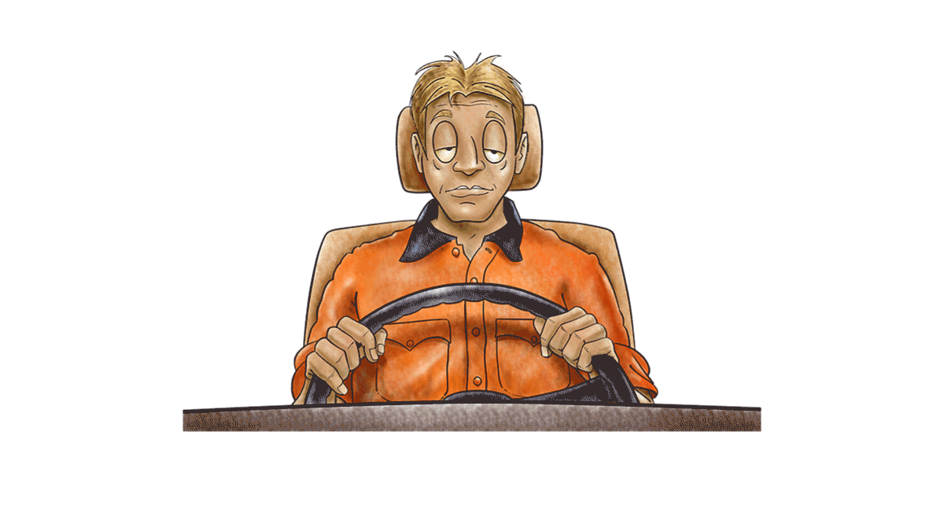
INTRODUCTION
What is drowsiness?
A state of being tired, lethargic, or lacking in alertness and awareness.
Major issue of road accidents.
What is Drowsiness detection model?
These models are specifically designed to identify early signs of tiredness in people, using modern techniques like computer vision and deep learning by monitoring the eye movements and facial expressions .

Slide 3

OBJECTIVE
The goal of this project is to ensure the safety system by creating a model for drowsiness detection that can quickly and precisely recognise signs of tiredness in drivers in a variety of scenarios to prevent accidents .
These systems use modern technologies like computer vision, deep learning, and physiological sensors to improve safety by promptly alerting users or initiating actions when drowsiness is identified

Slide 4

MOTIVATION
Nowadays there is a huge increase in transportation day by day.
Drivers can get get tired and drowsy which can lead to accidents.
In order to avoid these accidents, its important to detect the alertness of driver continuously.
When the face is detected , driver must be alerted if he is drowsy.
Through this we can avoid accidents and save lives of people.

Slide 5
ABOUT DATASET
The dataset was collected using Unity Eyes
The source from where we got data is Kaggle.
It was labelled using an arbitrary threshold of openness=20 .
Dataset comprises a diverse collection of eye movement recordings captured under controlled driving scenarios.
The data includes sequences of eye images, meticulously labelled to indicate whether the eyes are open or closed.
Dataset size: 552 MB

Slide 6

Data splitting
Data Loading and transformation
Data preparation
Analyze model predictions
Model selection
WORKFLOW
Define optimizer and loss function
Testing model
validation
Training model

Slide 7
IMAGE PROCESSING
The primary aspect of drowsiness detection is image processing, which allows for the immediate evaluation of face warning signs and fast actions.
Live images are taken using a camera and processed through many steps, such as facial landmark and face detection.
This makes it possible to precisely monitor facial expressions and eye movements, which are important signs of drowsiness.
These features are subsequently classified using deep learning techniques, enabling real-time evaluations.
At the end of the process, an alert system is activated, which then sends out immediate warnings.

Slide 8
METHODOLOGY OF EYE DETECTION
Step1:- Input the image and image processing
Step2:- Detecting the face in the image and creating a region of interest
Step3:- Detect the eyes and feed it
Step4:- Compare whether the is eye opened or closed
Step5:- Calculate the score to check whether the person is drowsy
Step6:- If the level of fatigue is more then the alert is given.
Step7:- Alert is given until the driver wakes up

Slide 9
FLOWCHART +-----------------+ | (Computer Vision) +-----------------+ +---------------------+ | Image Capture | | | | (Camera) +-------->| Face Detection | +-----------------+ | (Computer Vision) | +----------+----------+
Image capture
(by camera)
Face detection
Facial landmark detection
DL classification
Expression analysis
Eye tracking analysis
Real time assessment
Alert system activation

Slide 10
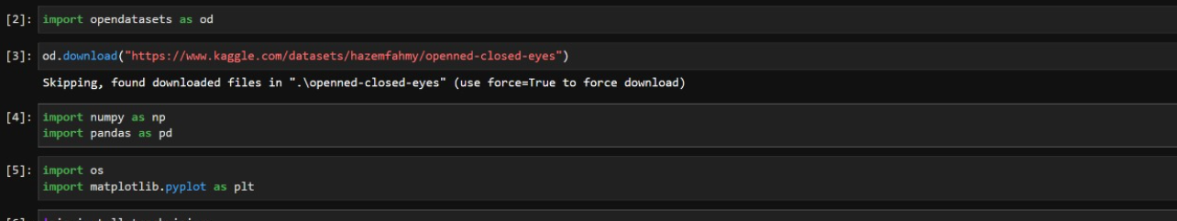
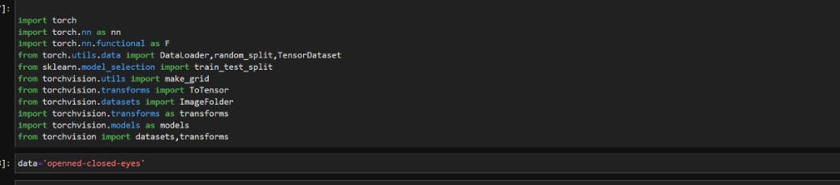
IMPORTING REQUIRED MODULES/LIBRARIES

Slide 11
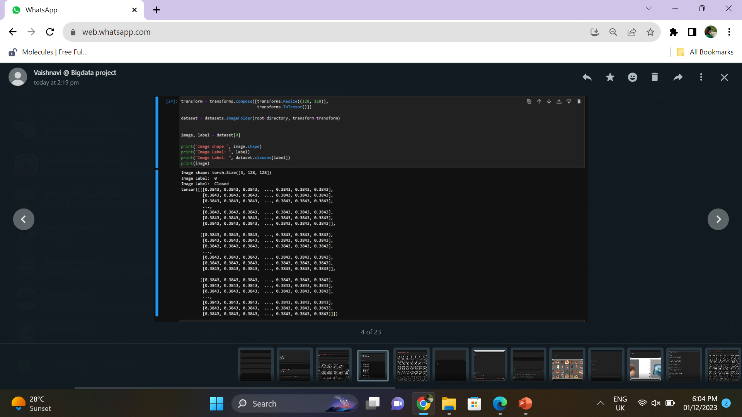
TRANSFORMATION

Slide 12
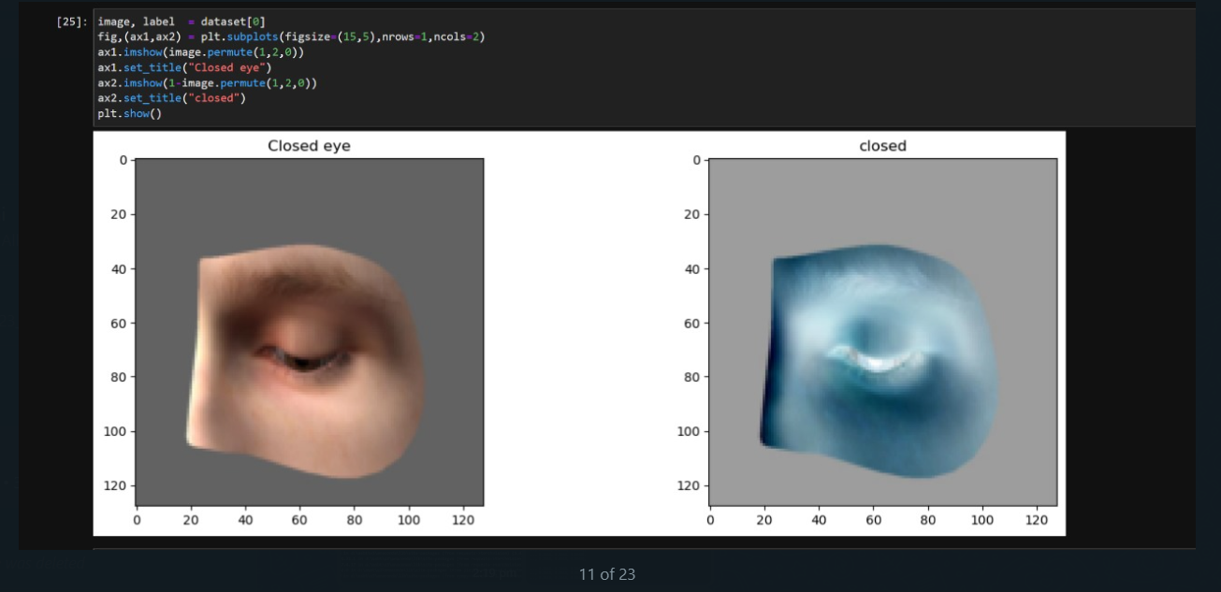
IMAGE PLOTTING

Slide 13
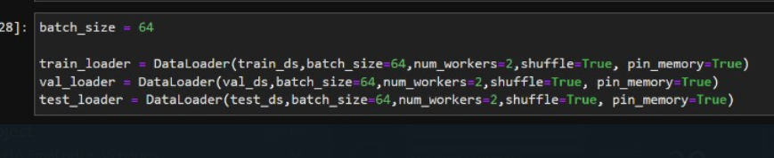
DATA LOADER

Slide 14
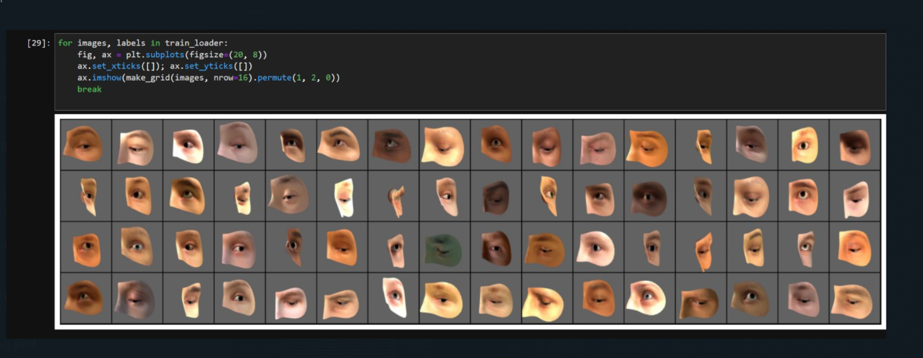
VIEW A BATCH OF IMAGES

Slide 15
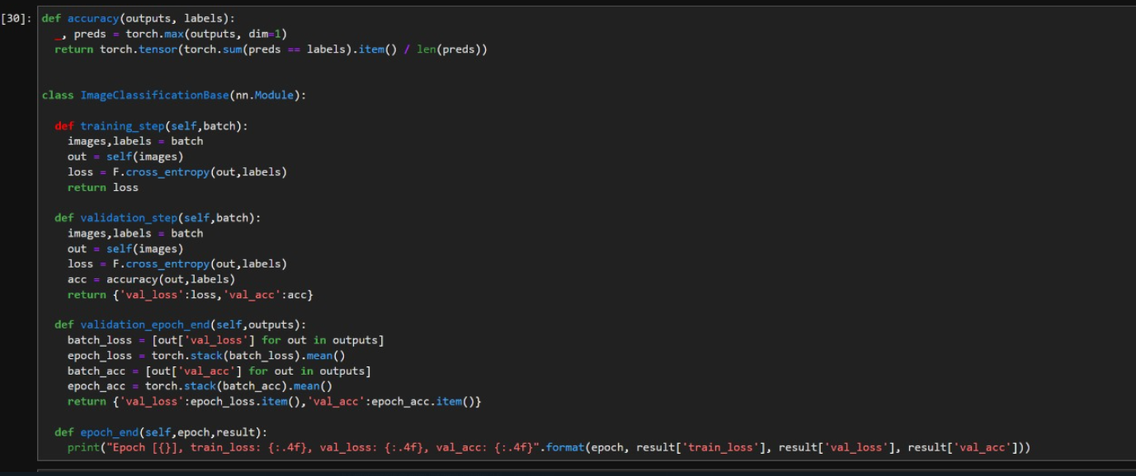
Base Class for defining training and validation steps

Slide 16
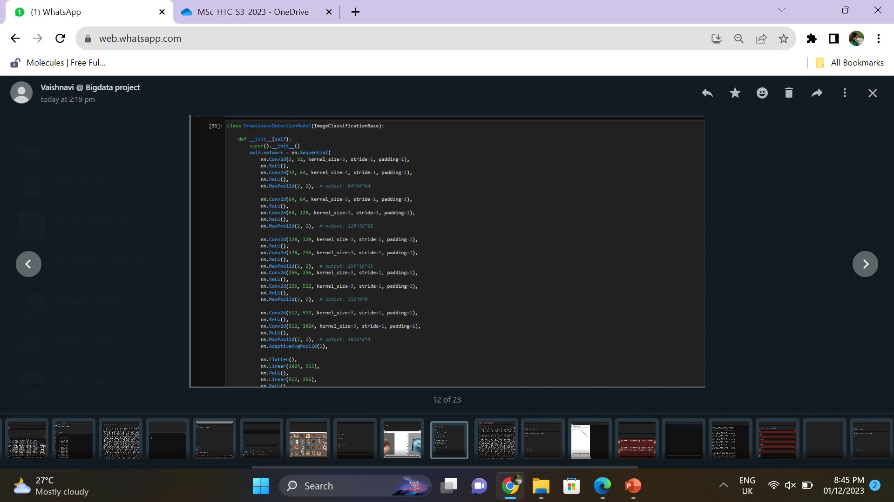
CONVOLUTIONAL NEURAL NETWORK

Slide 17
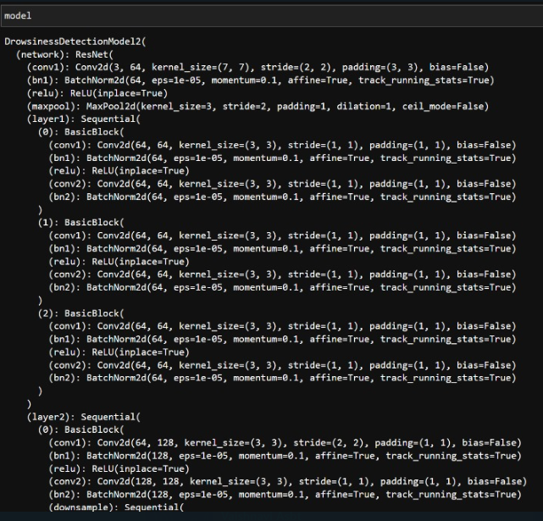
Model summary

Slide 18
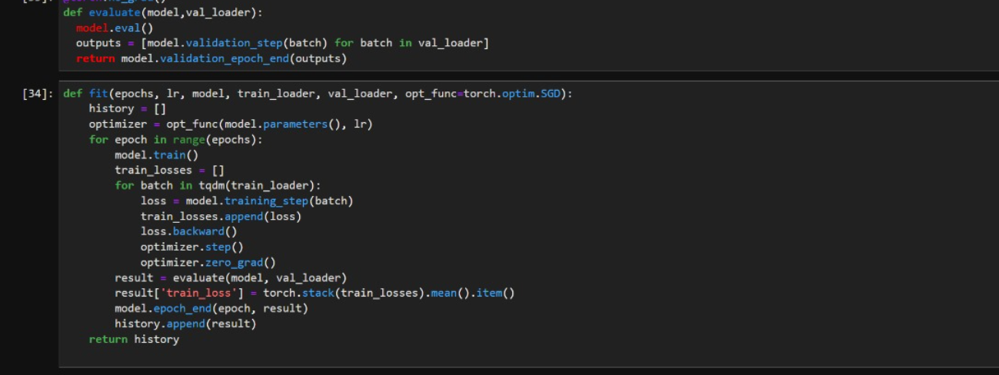
Training loop

Slide 19
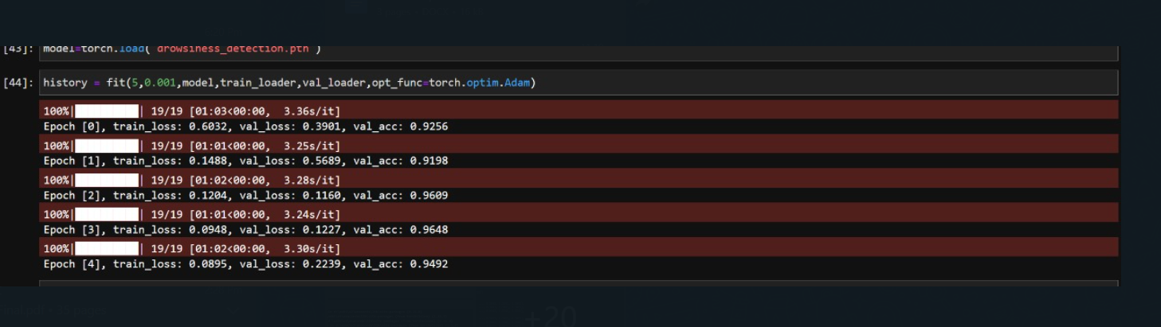

Slide 20
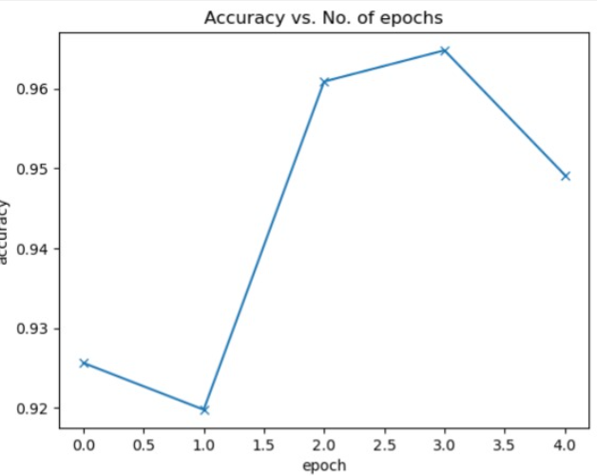

Accuracy vs No .of epochs

Slide 21
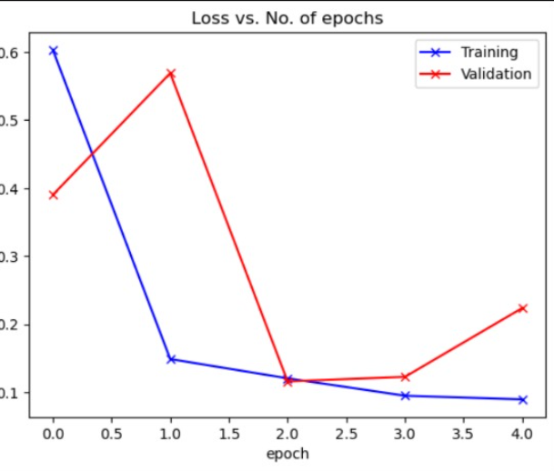

Loss vs No. of epochs

Slide 22
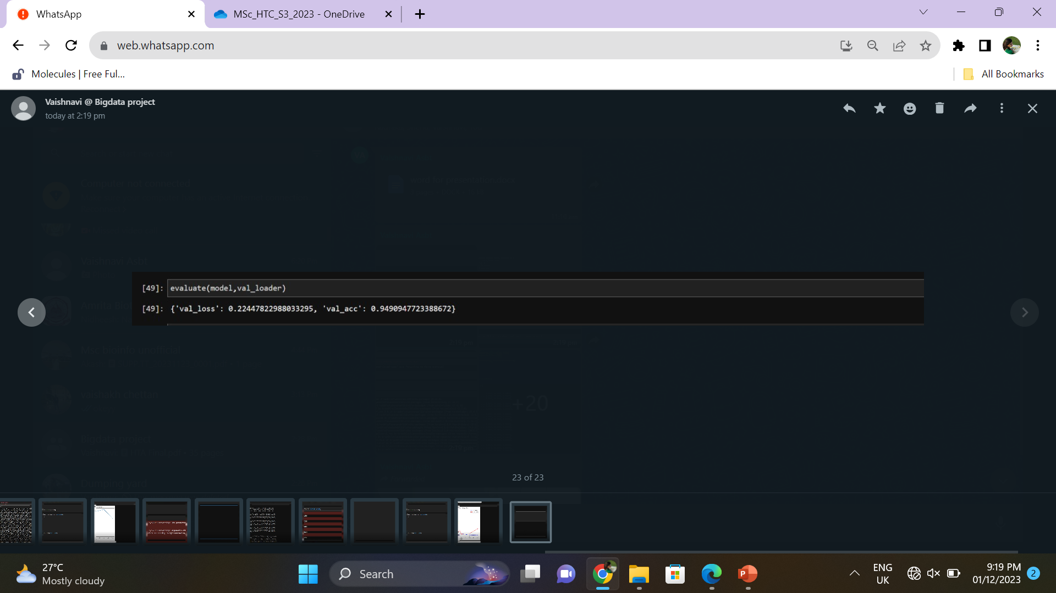
The low validation loss indicates that the model is effectively minimizing its prediction errors.
The high validation accuracy of 94.91% suggests that the model is making accurate predictions
CONCLUSION

Slide 23
REFERENCE
https://www.kaggle.com/datasets/hazemfahmy/openned-closed-eyes

Slide 24
THANK YOU
SUBMITTED BY:
Sneha Saji(AM.LS.P2BIF22029)
Vaishnavi P(AM.LS.P2BIF22033)

